Slide 1
Machine Learning in the Cloud
Lecturer: Ngo Huy Bien
Software Engineering Department
Faculty of Information Technology
VNUHCM - University of Science
Ho Chi Minh City, Vietnam
nhbien@fit.hcmus.edu.vn

Slide 2

Objectives

Slide 3

Contents

Slide 4

References
Akash Tandon et al. (2022). Advanced Analytics with PySpark. O'Reilly Media.

Slide 5
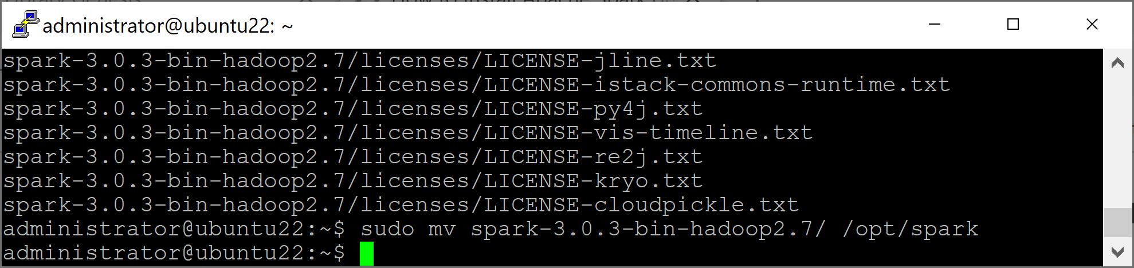
1. Install Spark on Ubuntu 22.04
https://linuxgenie.net/how-to-install-apache-spark-on-ubuntu-22-04/
sudo apt update
sudo apt install default-jdk
wget https://archive.apache.org/dist/spark/spark-3.0.3/spark-3.0.3-bin-hadoop2.7.tgz
tar xvf spark-3.0.3-bin-hadoop2.7.tgz
sudo mv spark-3.0.3-bin-hadoop2.7/ /opt/spark

Slide 6
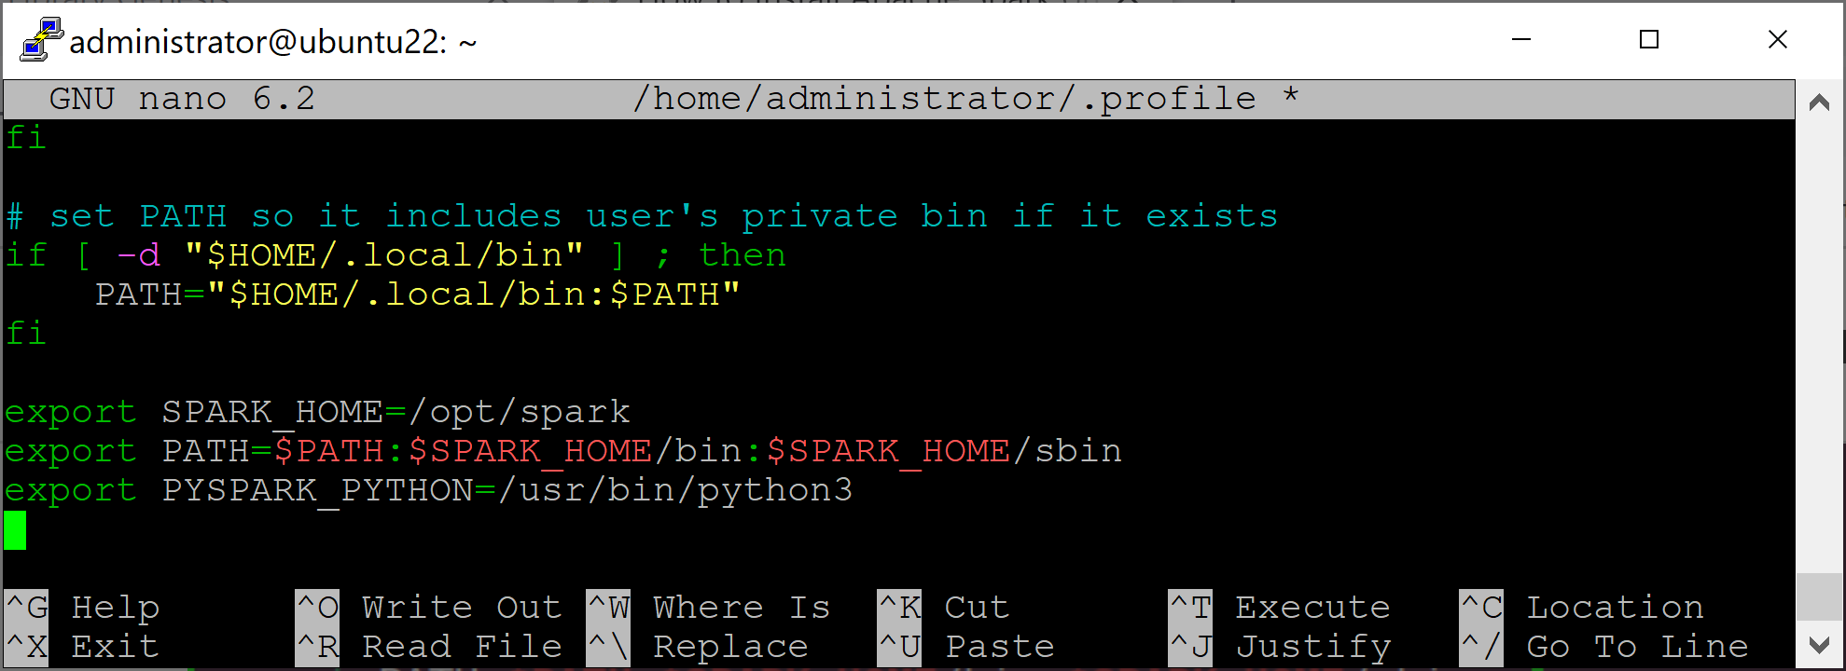
2. Configure Spark
sudo nano ~/.profile
export SPARK_HOME=/opt/spark
export PATH=$PATH:$SPARK_HOME/bin:$SPARK_HOME/sbin
export PYSPARK_PYTHON=/usr/bin/python3
source ~/.profile

Slide 7
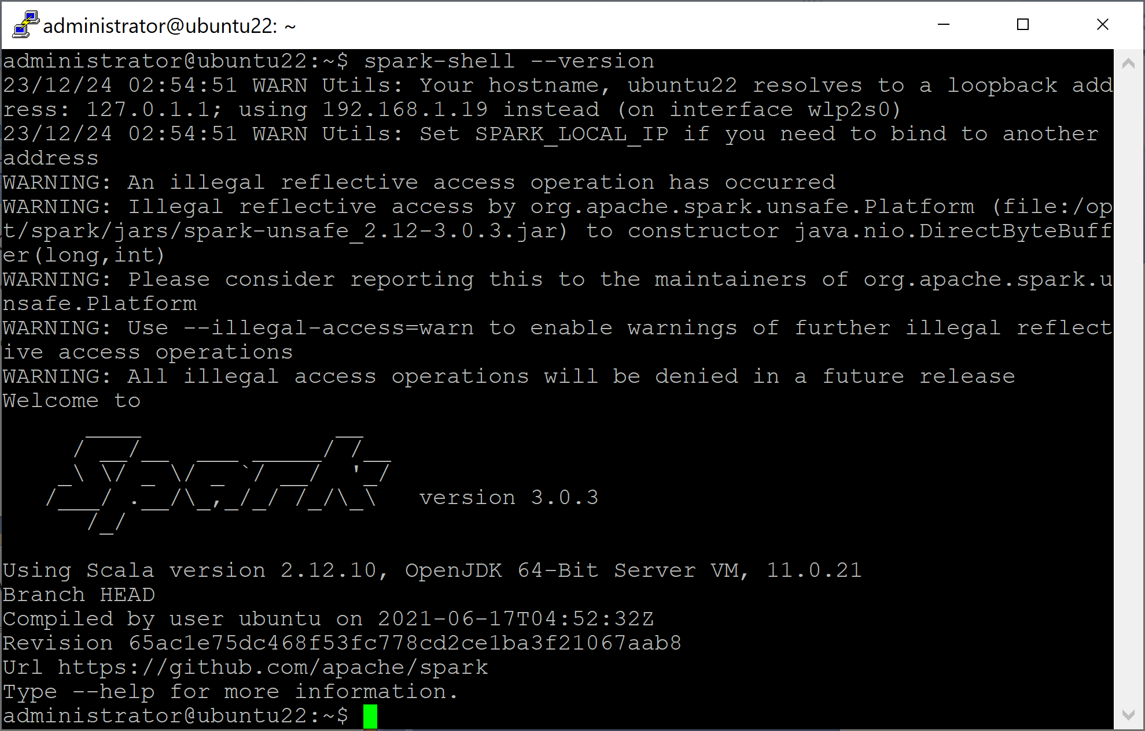
3. Verify Spark Installation
spark-shell --version

Slide 8


Slide 9
1. Install PySpark [1]
pip3 install pyspark
pip3 install pyspark[sql,ml,mllib]

Slide 10
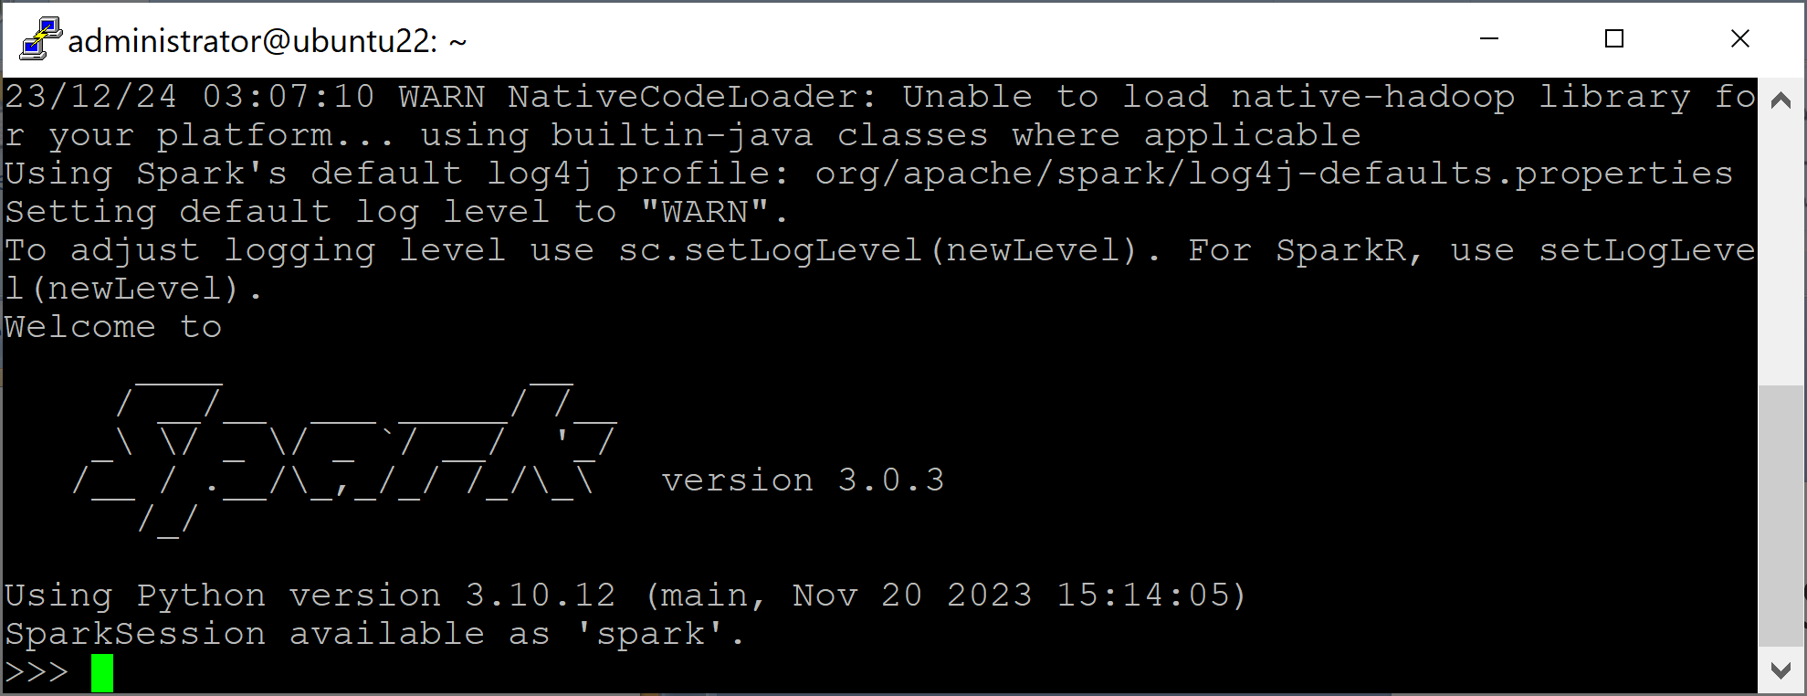
2. Launch PySpark Local Cluster
pyspark --master local[*]
# local[N], N is the number of threads to run,
# * match the number of cores available.

Slide 11
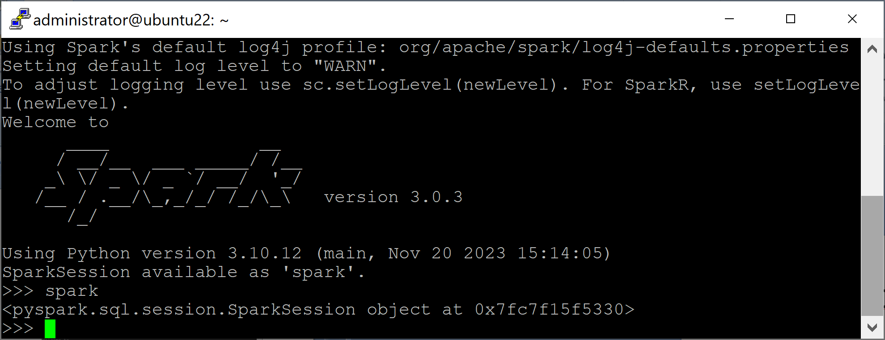
3. Open SparkSession
SparkSession acts as an entry point to all Spark operations and data.
spark

Slide 13
1. Download Data
mkdir linkage
cd linkage/
curl -L -o donation.zip https://bit.ly/1Aoywaq
unzip donation.zip
unzip 'block_*.zip'

Slide 14
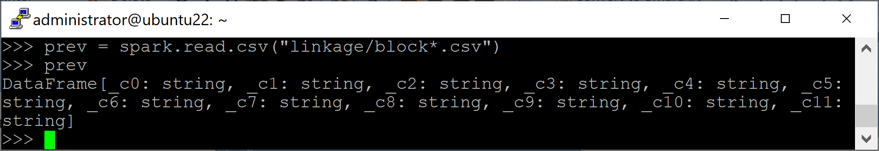
2. Create a dataframe
prev = spark.read.csv("linkage/block*.csv")
Prev
prev.show(2)

Slide 15
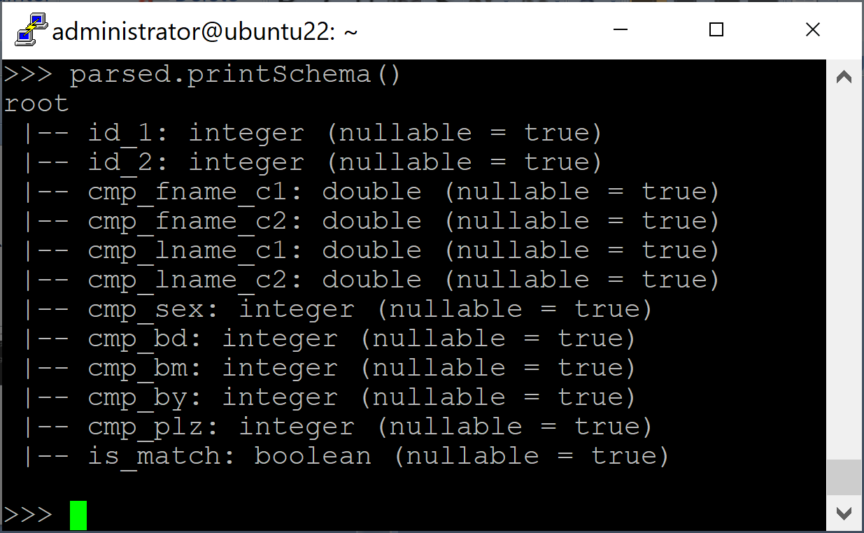
3. Print Schema
parsed = spark.read.option("header", "true").option("nullValue", "?").option("inferSchema", "true").csv("linkage/block*.csv")
parsed.printSchema()

Slide 17
1. Download Data
mkdir data
cd data/
curl -L -o covtype.data.gz https://github.com/manavpatel1092/Classification-of-Forest-Cover-Type/raw/master/covtype.data.gz
gzip -d covtype.data.gz

Slide 18
2. Install MLflow
pip3 install mlflow

Slide 19
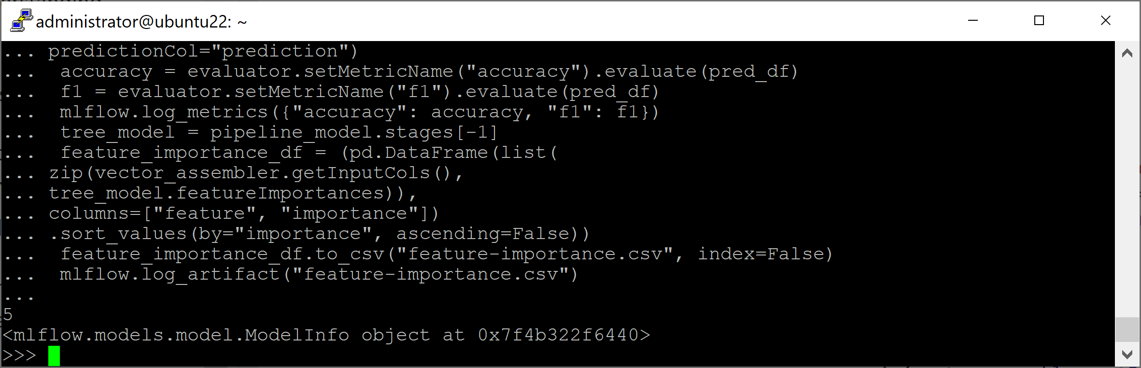
3. Train a Model in pyspark-shell
from pyspark.ml import Pipeline
from pyspark.sql.functions import col
from pyspark.sql.types import DoubleType
from pyspark.ml.feature import VectorAssembler
from pyspark.ml.classification import DecisionTreeClassifier
data_without_header = spark.read.option("inferSchema", True).\
option("header", False).\
...

Slide 20
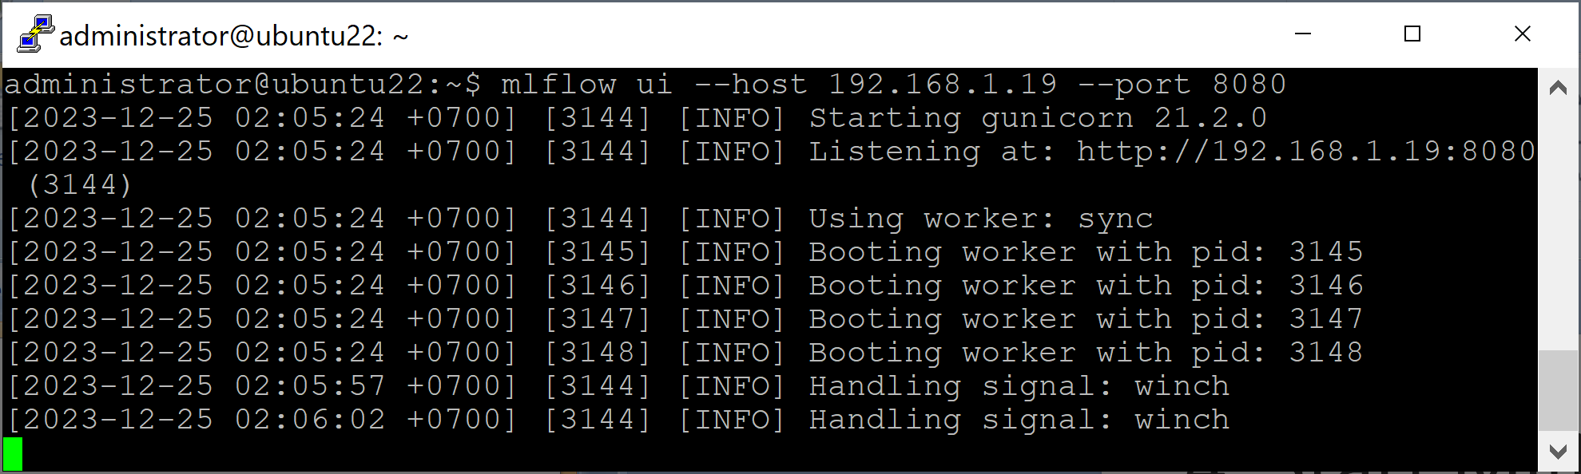
4. Start MLflow UI
mlflow ui --host 191.168.1.19 --port 8080

Slide 21
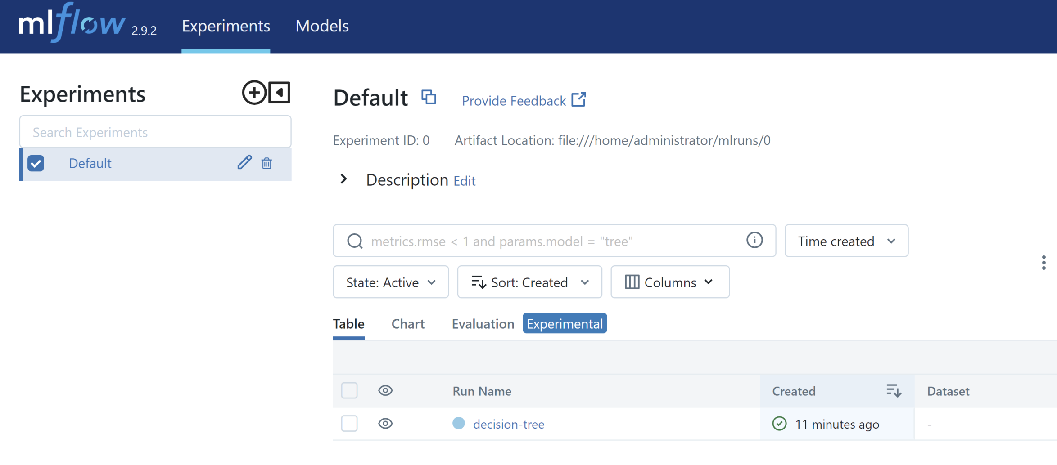
5. Open MLflow Tracking UI
http://192.168.1.19:8080/

Slide 23
https://colab.research.google.com/github/GoogleCloudPlatform/cloudml-samples/blob/master/notebooks/tensorflow/getting-started-keras.ipynb

Slide 25
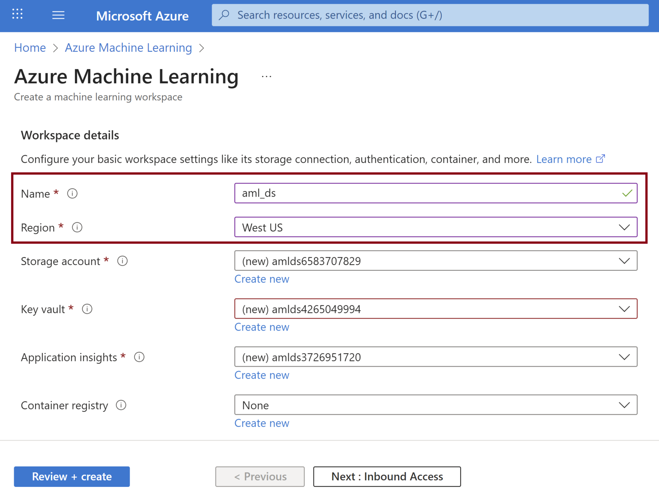
1. Create Azure ML Workspace

Slide 26
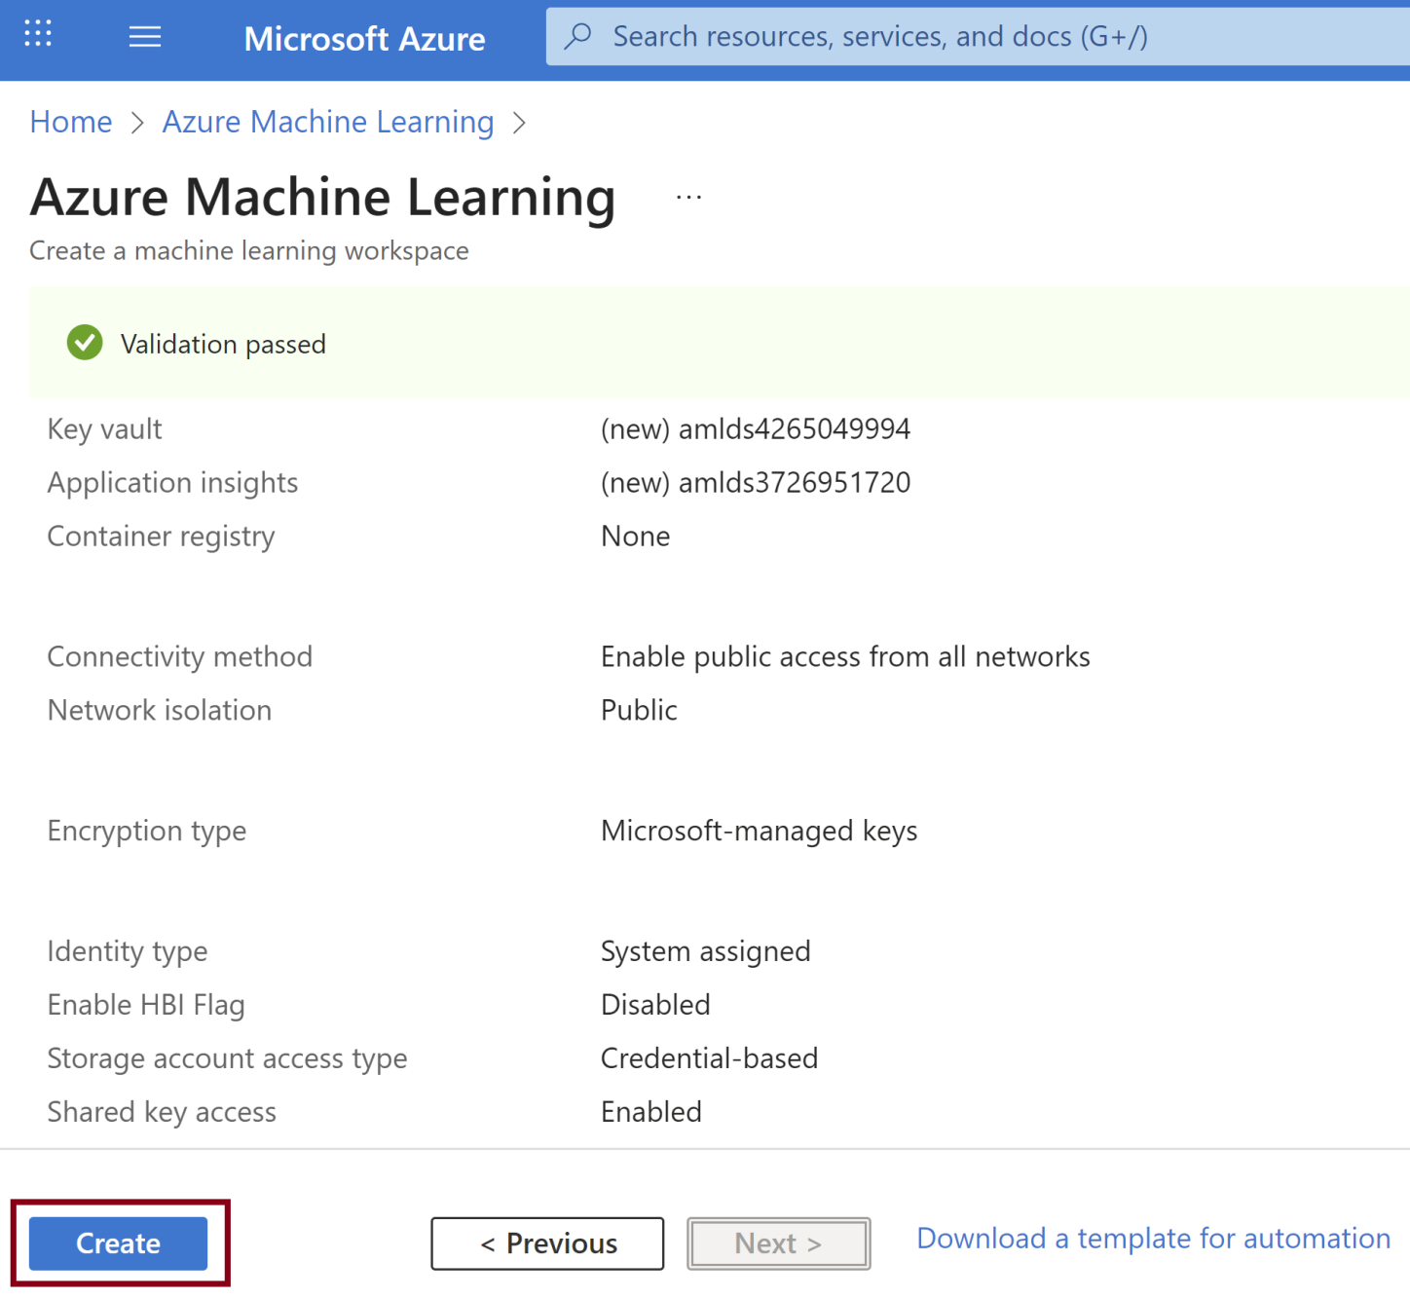
2. Confirm the Creation

Slide 27
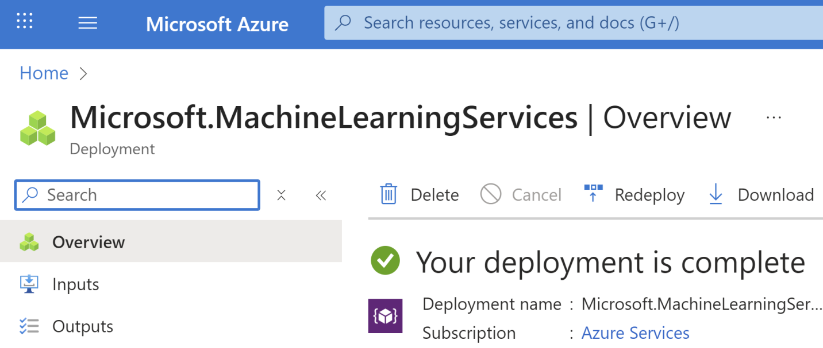
3. Review the Successful Completion

Slide 28
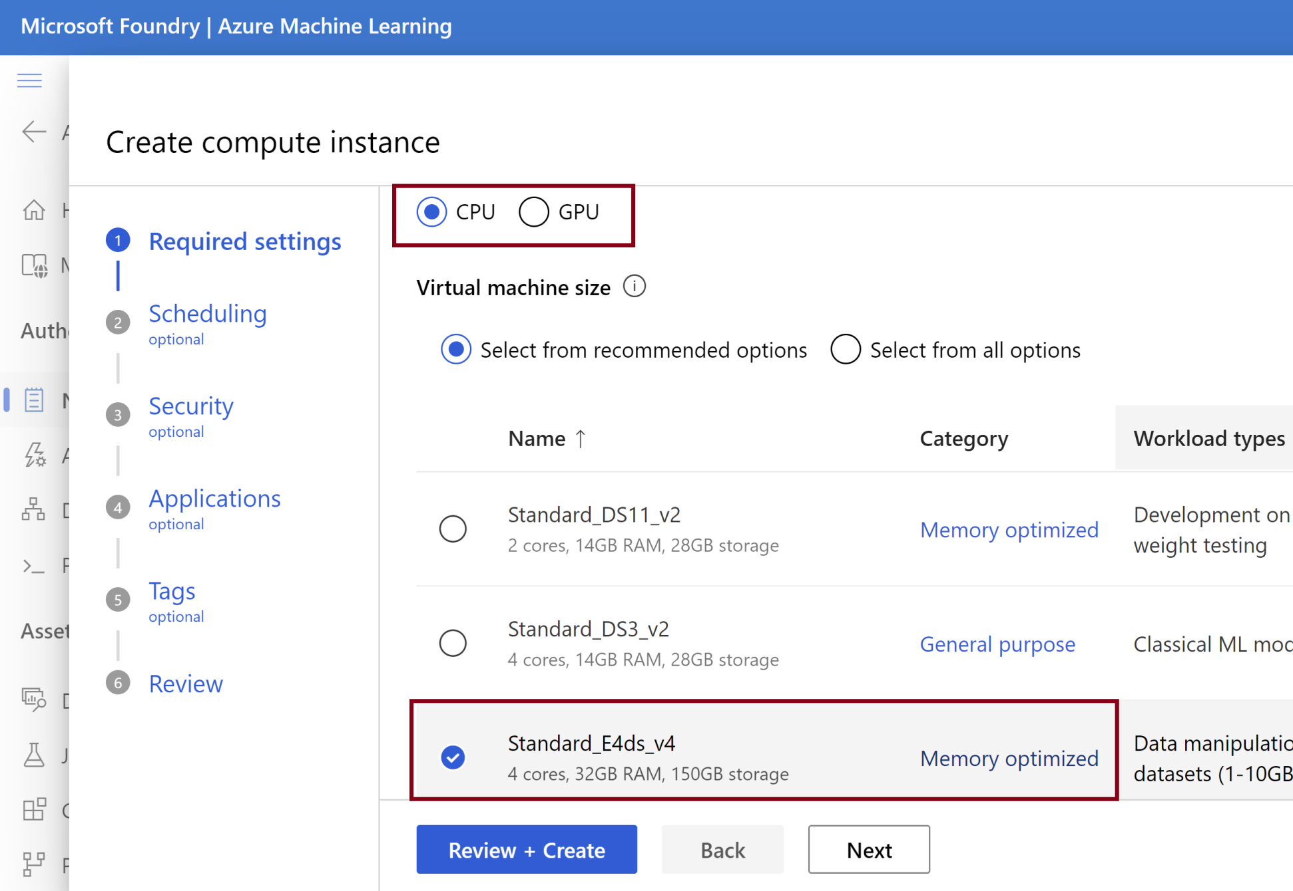
4. Create a Compute Instance

Slide 29
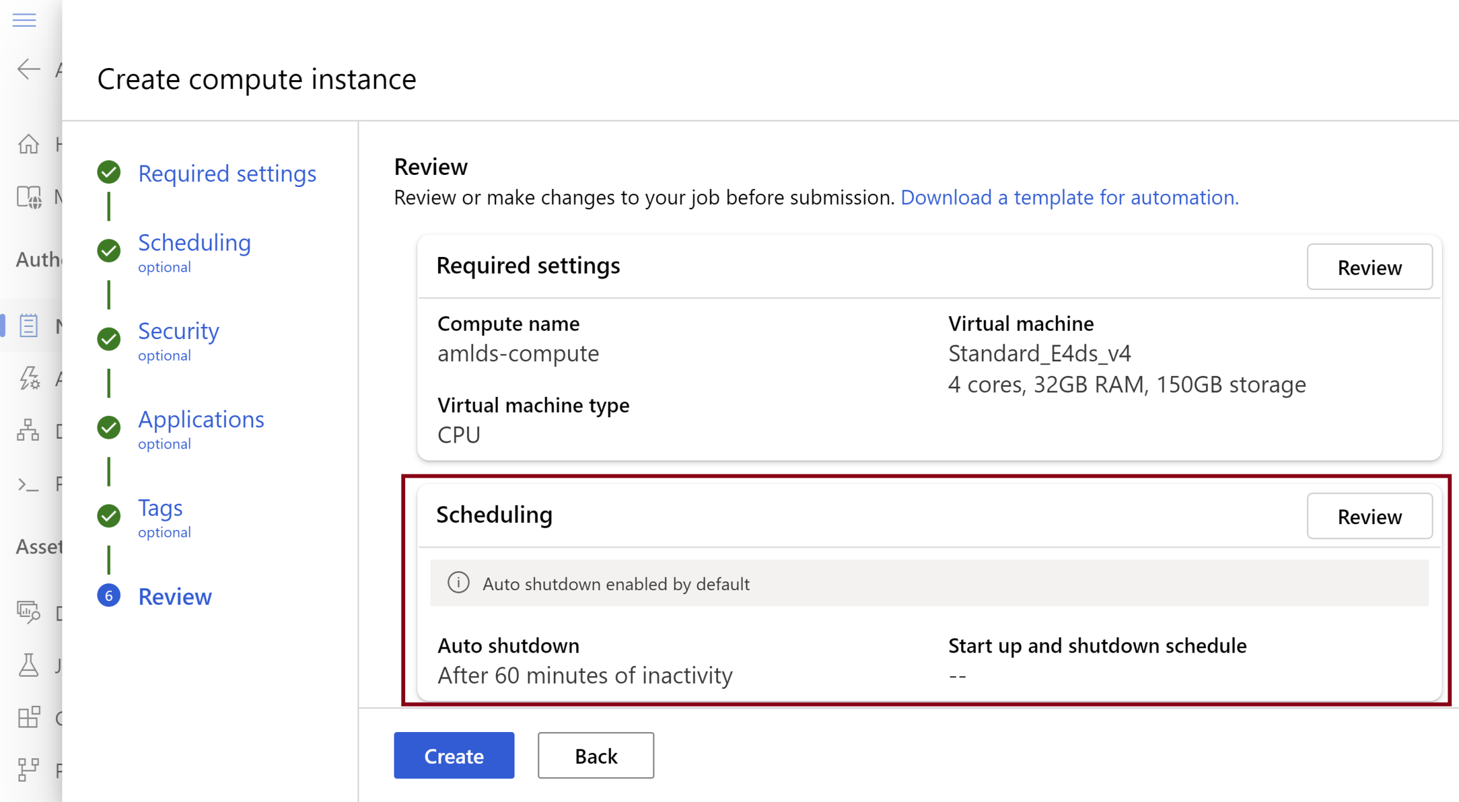
5. Confirm the Creation

Slide 31

Thank You & See You Again

